Slide 1
Gunpowder River Woody Debris
Bunker Hill Road to Falls Road
Distance ≈ 1.5mi. (2.4 km)
March 15, 2011

Slide 2
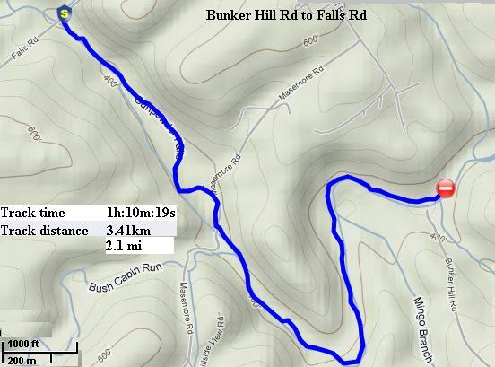
Continuous photo inventory of woody debris
GPS recorded route

Slide 3
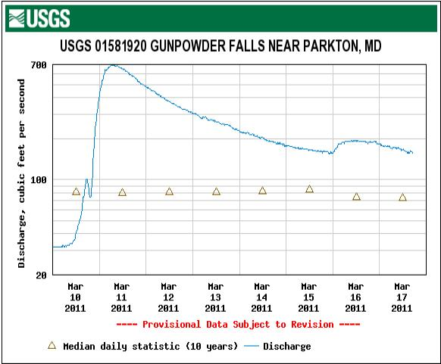
Flow

Slide 4
Station 1 Start
Notes:
Across from Camp Woods but down stream from the climbing wall.

Slide 5
Station 2

Slide 6
Station 3

Slide 7
Station 4

Slide 8
Station 5

Slide 9
Station 6

Slide 10
Station 7a

Slide 11
Station 7b
Strong current on blind bend.
Notes:
Fun for experienced paddlers, hazardous for the inexperienced.
Often the location of troublesome fallen trees.

Slide 12
Station 8

Slide 13
Station 9a
Notes:
River right is only available at high flows.

Slide 14
Station 9b
A favorite of fishermen.
Notes:
The large eddy is used by many fishermen.

Slide 15
Station 10

Slide 16
Station 11a
This log jam has been in place since at least May 2009.
Notes:
No easy portage without damage to banks.
Has a strong under current.
Has force hikers and fishermen to cut a new trail due to the eroding and undercut bank.

Slide 17
Station 11b
North Trail erosion due to log dam.

Slide 18
Station 11c

Slide 19
Station 12a
Tree pushed from main stream.

Slide 20
Station 12b

Slide 21
Station 13

Slide 22
Station 14
Masemore Rd Bridge

Slide 23
Station 15
South Trail cleared and logs pushed into river.

Slide 24
Station 16

Slide 25
Station 17a

Slide 26
Station 17b

Slide 27
Station 20

Slide 28
Contact Information
Charles Hihn
18426 Gunpowder Rd
Hampstead, MD 21074
buddyh@hiventures.com
410-374-4164

